Slide 1

Summer Internship Grant Orientation
Presented by Career Development & Internships
Up to
$2000

Slide 2



Purpose and Objectives
Application process
Eligibility and criteria
Required career development activities
Documentation
Timelines
FAQ’s
Next Steps
Sign In Sheet: IMPORTANT STEP TO RECEIVE MATERIALS

Slide 3
Eligibility and Criteria
Intended for students planning to work after SUA vs. grad school
Must be current sophomore or junior in good academic standing
Internship must be completed in HOME country
Must complete internship during summer
Internship must be at least 8 weeks
Internship must be at least 20 hours per week
Student are responsible for:
finding and applying to a non-paid internship
completing career development activities prior to application deadline
communicating with the Internship site for all required information
*Must be a non-[paid position or, pay is less than a total of $2000 for the entire internship.

Slide 4

Application
SUMBIT the following documents:
Completed Application Form
Career Development Checklist
Essay
Your essay should outline your reasons for wanting the internship, what you hope to learn and how it might help you decide on your career plan.
Resume and cover letter
(Reviewed by CDO)
Essay
(See application for instructions)
Copy of organization’s webpage or brochure
Site Verification Form
Copy of position description from the organization

Slide 5
Application Timeline
Please familiarize yourself with the important application timelines
 | Complete tasks: Resume/Cover Letter Write Essay Join HANDSHAKE Attend required career preparation appointments with CDO
Search for appropriate and interesting internships
 |  | Apply to organization and secure internship | Turn in application to Career Services
ongoing |  |  | By 5:00 pm May 20, 2022
Application DEADLINE | Selection | First check received | Leave campus
May 20, 2022 5:00 pm PDT | May 27 | June 3

Slide 6


FAQ
Q & A
Q: Do I have to find the internship on my own?
A: You must search, contact and apply directly to the internship organization. However, CDO may provide you with resources.
Q: What if my internship is 10 weeks but only 10 hours a week?
A: Your internship MUST meet BOTH criteria of at least 8 weeks and at least 20 hours per week. However, it can be more than either.
Q: What if I want to do an internship after study abroad?
A: You must complete the activities before you leave campus and you must find an internship in your home country.
Q. How many people apply and what are my chances to receive the grant?
A. Every year is different and it depends how many apply and the quality of the internship. However, in the past cycles there has been approximately 75% acceptance.

Slide 7

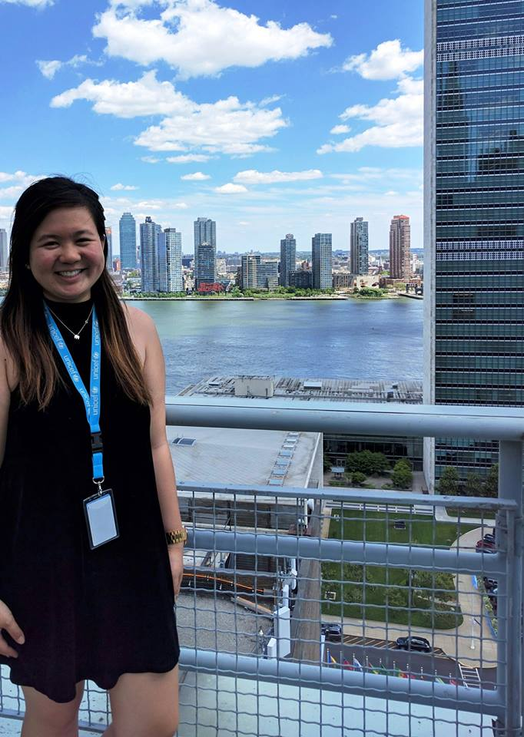

Who Is This?
Why is She Smiling?

Slide 8
Next Steps
Review the application packet/materials
Send some good times for us to meet to get the process started
Start searching for internships
Start to prepare or update your resume and cover letter

Slide 9
Sign In Sheet
To confirm your participation in this orientation and be included on the distribution list, please sign in.

